Slide 1

Data
Insights to
Microsoft Movies studio
~by Jackson Munene
Next
Notes:
Links:
https://pixabay.com/vectors/connection-internet-digital-network-4166469/

Slide 2

Problem Statement
Microsoft
has decided to create a new movie studio, but they don’t know anything about movie industries.
They need valuable insights from specific data from these three movie companies:
Box Office Mojo
The Numbers
The Movies DB
Notes:
Links:
https://www.pexels.com/photo/photo-of-people-looking-on-laptop-3182801/

Slide 3



GOALS
As a data scientist, here are some of the important milestones before getting to the insights
Understanding the Datasets
Cleaning the datasets
Finding patterns and visual representations of data

Slide 4

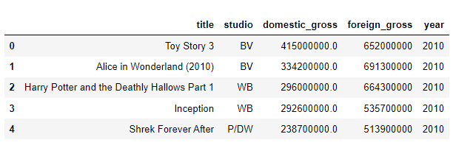
1) Box Office Mojo
This is how the first five records of the csv data from Box Office Mojo looks like:
There are only five features: Title, studio, domestic gross, foreign gross and year. This data defines the total amount of money a specific movie generated in the year of its release, both nationally and internationally.
Notes:
Links:
https://www.pexels.com/photo/smiling-middle-aged-man-using-tablet-and-holding-apple-near-window-in-office-3931603/
https://www.pexels.com/photo/smiling-woman-with-notebook-in-office-hall-4173256/
https://www.pexels.com/photo/cheerful-woman-smiling-while-sitting-at-table-with-laptop-4467687/

Slide 5
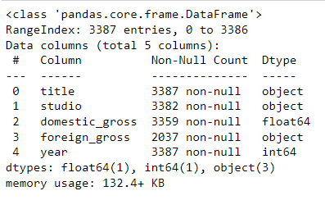
.info()
This is how the high level information about the data from Box Office Mojo:
There are a total of 3,387 records in the dataset, and 5 features. 3 of the features are in string data type, 1(year) is an integer and 1(domestic gross) is a floating value. Notice the inconsistency with the dataset datatype:
Foreign gross is keyed in like a string. We need to change it to a floating value to perform calculations with it.
Notes:
Links:
https://www.pexels.com/photo/smiling-middle-aged-man-using-tablet-and-holding-apple-near-window-in-office-3931603/
https://www.pexels.com/photo/smiling-woman-with-notebook-in-office-hall-4173256/
https://www.pexels.com/photo/cheerful-woman-smiling-while-sitting-at-table-with-laptop-4467687/

Slide 6

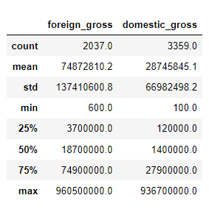

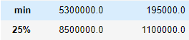
Statistical Measures
Here is min, max, mean, median, standard deviation, count and quantiles of both domestic and foreign gross
Notice the outliers, from min to the 25th percentile.
We change that by removing the outliers through getting data between 30% and 70% to look like as follows.
Notes:
Links:
https://www.pexels.com/photo/multi-cultural-people-3184419/

Slide 7
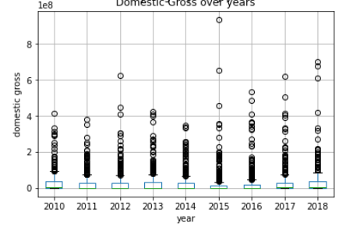
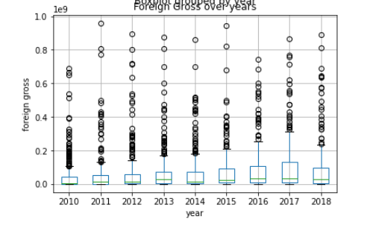
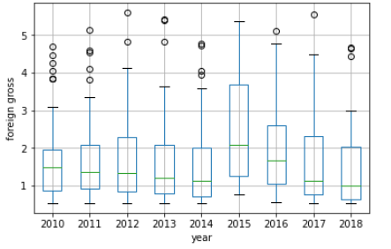
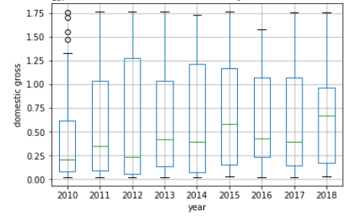
Domestic Gross
Foreign Gross
From:
Another way to visualize these outliers is through:
From:
Box Plots
To:
To:
Notes:
Links:
https://www.pexels.com/photo/photo-of-people-looking-on-laptop-3182812/

Slide 8
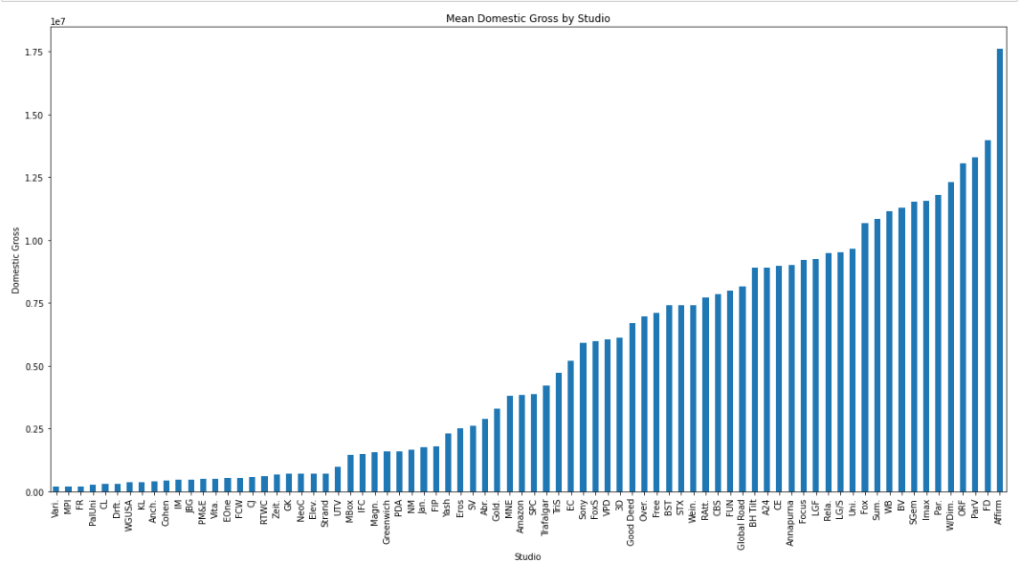
Which studio has the highest domestic gross?
A bar graph representation for categorical feature(Studio) will be needed for this.
1st we’ll group the domestic gross column by studio.
Get the mean of the grouped data
Sort the values in ascending order
Then plot the bar graph.
We can conclude that after we removed the outliers, Vari. and MPI studios have the least while Affirm has the highest domestic Gross.
Notes:
Links:
https://www.pexels.com/photo/smiling-middle-aged-man-using-tablet-and-holding-apple-near-window-in-office-3931603/
https://www.pexels.com/photo/smiling-woman-with-notebook-in-office-hall-4173256/
https://www.pexels.com/photo/cheerful-woman-smiling-while-sitting-at-table-with-laptop-4467687/

Slide 9
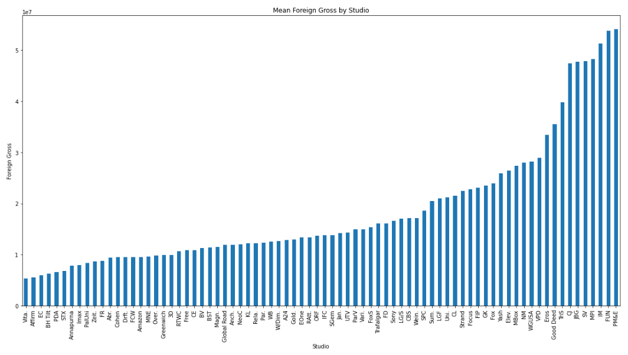
Which studio has the highest foreign gross?
The same will be done, but we only use Foreign Gross column in the data
1st we’ll group the foreign gross column by studio.
Get the mean of the grouped data
Sort the values in ascending order
Then plot the bar graph.
Here, the opposite is true from the observations such that Affirm generates the least while MPI is one of the highest Foreign gross generator.
Notes:
Links:
https://www.pexels.com/photo/smiling-middle-aged-man-using-tablet-and-holding-apple-near-window-in-office-3931603/
https://www.pexels.com/photo/smiling-woman-with-notebook-in-office-hall-4173256/
https://www.pexels.com/photo/cheerful-woman-smiling-while-sitting-at-table-with-laptop-4467687/

Slide 10

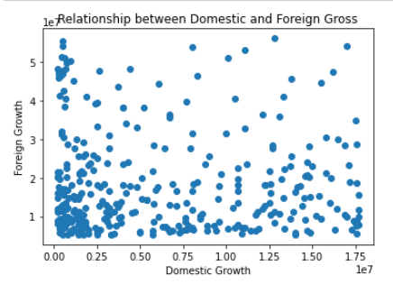

Gross Relationship
As much as the studios which generate the most domestic gross perform so low in foreign gross, there is no concrete connection between domestic and foreign gross.
Their correlation is: -0.01509821
Notes:
Links:
https://www.pexels.com/photo/multi-cultural-people-3184419/

Slide 11
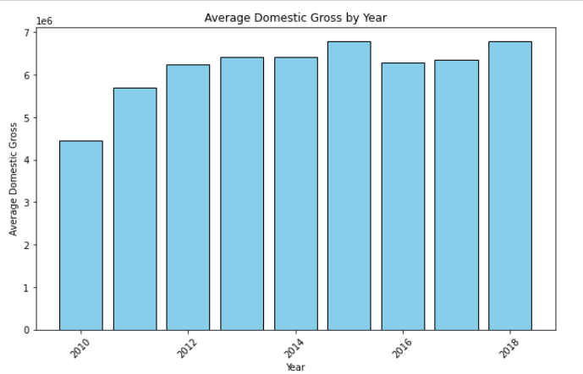
Domestic Gross growth
A bar graph representation for the average Domestic gross per year will be needed for this.
1st we’ll group the domestic gross column by year.
Get the mean of the grouped data
Then plot the bar graph.
Notice a slight positive gradual growth over the years.

Slide 12
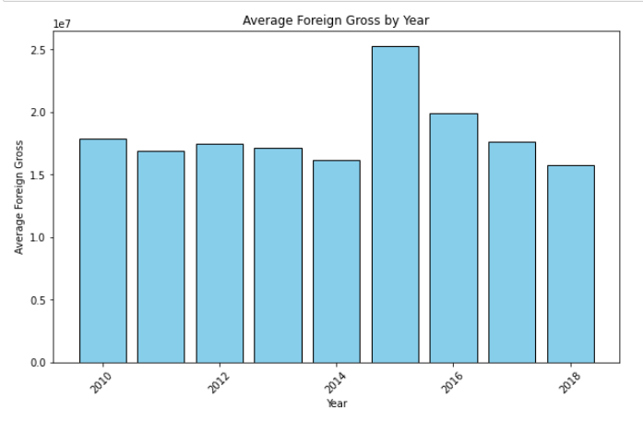
Foreign Gross growth
The same is not true with foreign gross.
1st we’ll group the Foreign gross by year.
Get the mean of the grouped data
Then plot the bar graph.
In the foreign gross, there is not so much improvements, only that in 2015, the gross went up.

Slide 13
Recommendations
Microsoft should consider partnering with Affirm studio to generate high Domestic gross and also MPI and FUN studios for high foreign gross.
Microsoft should also find a way to automate data entry to minimize mistakes like getting outliers because of wrong data entry.
The stakeholders should concentrate on both domestic and foreign gross, because they are both independent.

Slide 14
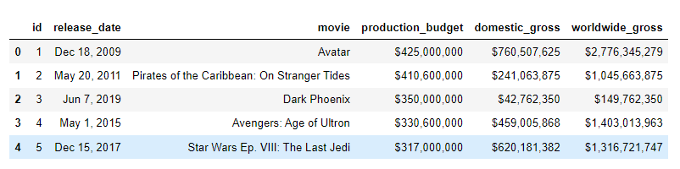
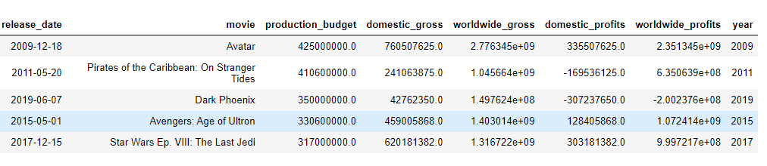
2) The Numbers
Here is a slight peek into The Numbers csv file:
There are a lot of things that have to be changed like:
Removing $ and comma(,) signs from Production Budget, Domestic gross and worldwide gross.
We will also need to add few more features like domestic profits, year and worldwide profits.
Notes:
Links:
https://www.pexels.com/photo/smiling-middle-aged-man-using-tablet-and-holding-apple-near-window-in-office-3931603/
https://www.pexels.com/photo/smiling-woman-with-notebook-in-office-hall-4173256/
https://www.pexels.com/photo/cheerful-woman-smiling-while-sitting-at-table-with-laptop-4467687/

Slide 15
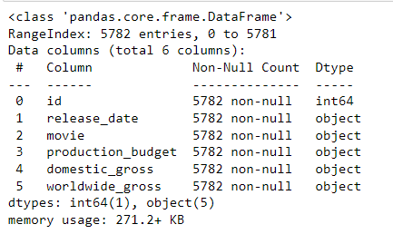
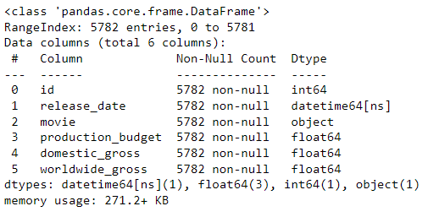
.info()
The data has 5,782 rows and 6 columns which are all objects except from the Id.
There are a lot of things that have to be changed like:
Changing data types of production budget, domestic gross, and worldwide gross to floating values.
Release date should also be in datetime datatype.
Notes:
Links:
https://www.pexels.com/photo/smiling-middle-aged-man-using-tablet-and-holding-apple-near-window-in-office-3931603/
https://www.pexels.com/photo/smiling-woman-with-notebook-in-office-hall-4173256/
https://www.pexels.com/photo/cheerful-woman-smiling-while-sitting-at-table-with-laptop-4467687/

Slide 16

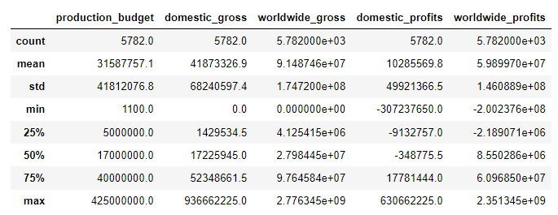
Statistical Measures
Before cleaning the dataset, notice the outliers from 75% percentile to max in all of the features.
We have to clean that by dropping the data so it looks as follows:
Notes:
Links:
https://www.pexels.com/photo/multi-cultural-people-3184419/

Slide 17
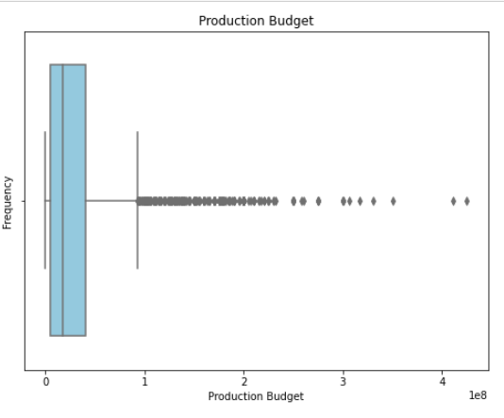
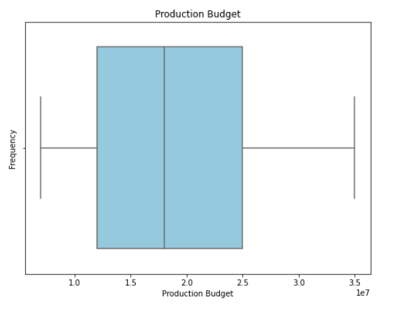
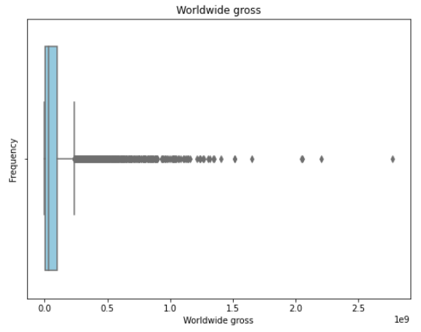
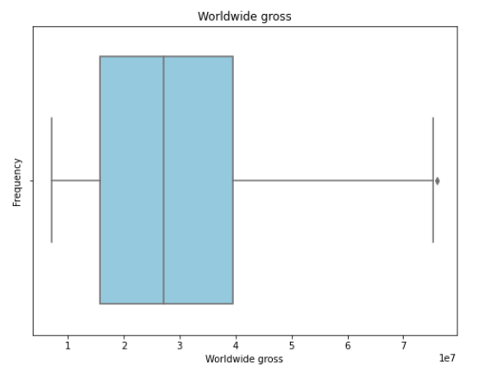
Below is another way to visualize the outliers and what will happen to the data when those outliers are removed.
before
after
Box plots

Slide 18
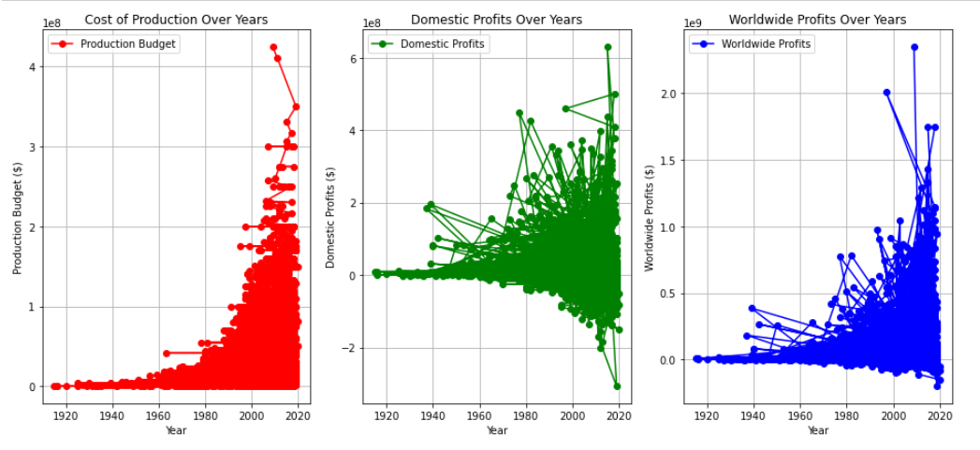
Does Production budget affect Profits?
The higher the production budget, the higher the worldwide profits, but the same is not true with domestic profits.
The correlation between production budget and worldwide profits is 0.6087521.
While the correlation between the product budget and domestic budget is 0.099742.
Notes:
Links:
https://www.pexels.com/photo/smiling-middle-aged-man-using-tablet-and-holding-apple-near-window-in-office-3931603/
https://www.pexels.com/photo/smiling-woman-with-notebook-in-office-hall-4173256/
https://www.pexels.com/photo/cheerful-woman-smiling-while-sitting-at-table-with-laptop-4467687/

Slide 19
Recommendations
Microsoft should prioritize increasing the cost of producing movies, as worldwide profits are highly dependent on this factor. Investing in high-quality productions can attract larger audiences globally, leading to greater financial returns.
To avoid messy data and streamline operations, stakeholders should explore automation solutions for data entry and management processes. This will enhance efficiency and ensure data integrity across all stages of movie production and analysis.

Slide 20
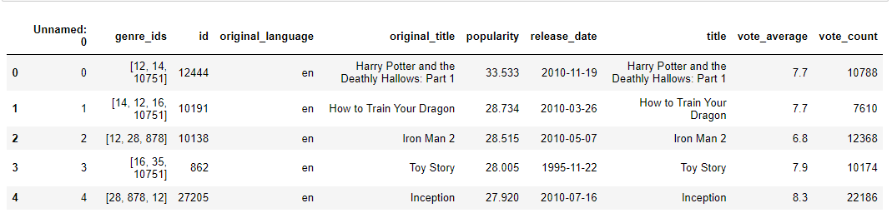
3) The Movie DB
This is how the first five records of the csv data from The Movie DB looks like:
They have a lot more features than the other datasets, and they also have average vote counts of each movie and their popularity.
Notes:
Links:
https://www.pexels.com/photo/smiling-middle-aged-man-using-tablet-and-holding-apple-near-window-in-office-3931603/
https://www.pexels.com/photo/smiling-woman-with-notebook-in-office-hall-4173256/
https://www.pexels.com/photo/cheerful-woman-smiling-while-sitting-at-table-with-laptop-4467687/

Slide 21
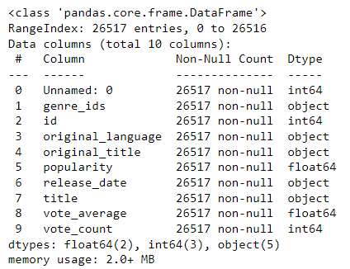
.info()
In this high level overview of the data, we find that:
We have 10 columns
26,517 records
A mix of floating values and strings.
No null values
The just need to change release date datatype to datetime.
Notes:
Links:
https://www.pexels.com/photo/smiling-middle-aged-man-using-tablet-and-holding-apple-near-window-in-office-3931603/
https://www.pexels.com/photo/smiling-woman-with-notebook-in-office-hall-4173256/
https://www.pexels.com/photo/cheerful-woman-smiling-while-sitting-at-table-with-laptop-4467687/

Slide 22
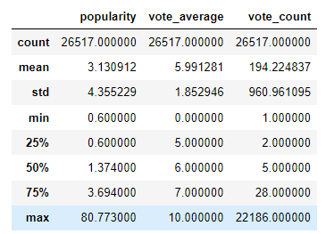
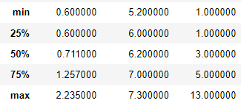
Statistical Measures
Notice the outliers, from min to the 25th percentile, and 75th to max.
We change that by removing the outliers through getting data between:
0.05 and 0.65 quantiles for popularity
0.3 and 0.8 quantiles for Average votes
0.005 and 0.65 quantiles for vote count.
Notes:
Links:
https://www.pexels.com/photo/multi-cultural-people-3184419/

Slide 23
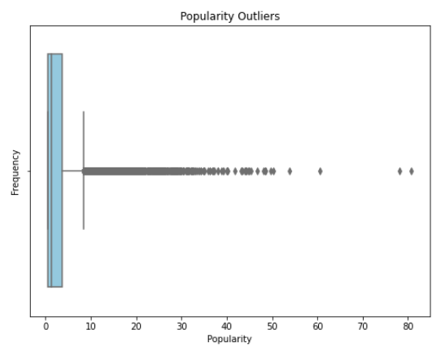
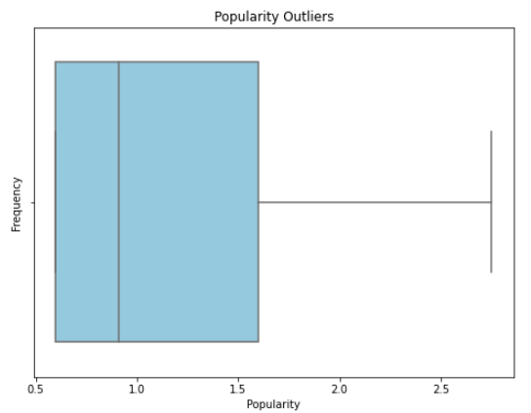
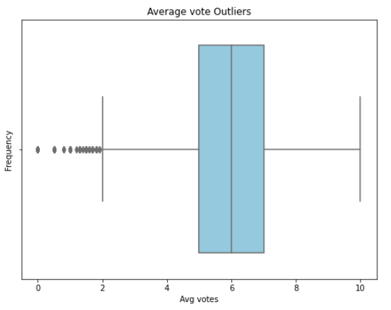
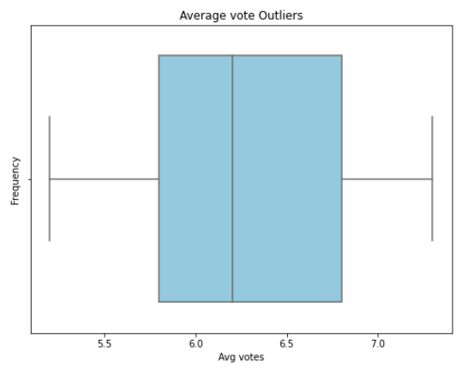
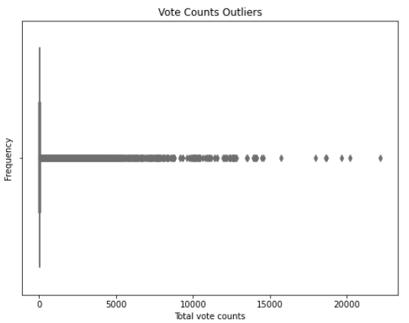
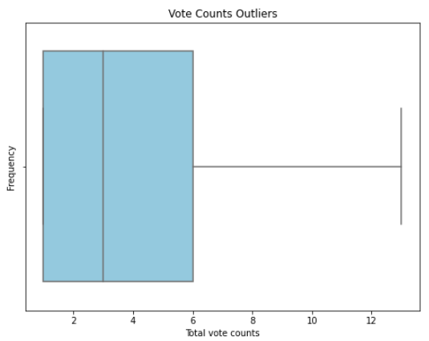
before
after
Let us visualize the outliers with a
Box plots

Slide 24
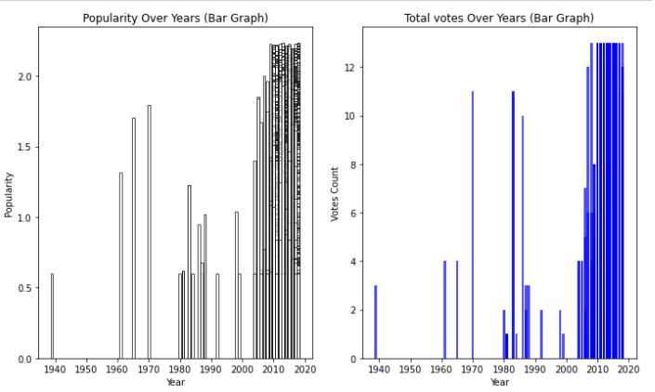
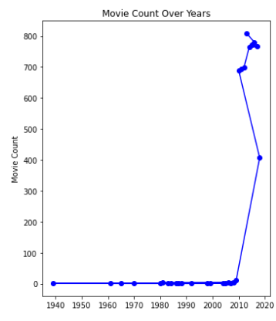
Does Vote count affect popularity?
Vote count is positively correlated to popularity, but it is not a strong correlation.
Correlation = 0.549394219698477.
The movie DB released less movies from 1940 to 2005, but started releasing a lot of movies from 2005 onwards, and gained a lot of votes and popularity there after.
Notes:
Links:
https://www.pexels.com/photo/smiling-middle-aged-man-using-tablet-and-holding-apple-near-window-in-office-3931603/
https://www.pexels.com/photo/smiling-woman-with-notebook-in-office-hall-4173256/
https://www.pexels.com/photo/cheerful-woman-smiling-while-sitting-at-table-with-laptop-4467687/

Slide 25
Recommendations
Given the broader market appeal, Microsoft should focus on releasing more English-language movies compared to other languages. English-language films tend to have higher sales potential and wider international distribution.
Volume Strategy for Popularity: Releasing a high number of movies can help Microsoft gain votes and popularity on platforms like The Movie DB. The number of movies released positively correlates with audience engagement metrics, such as votes and popularity, thus enhancing the studio's visibility and reputation.

Slide 26

Notes:
Links:
https://www.pexels.com/photo/multi-cultural-people-3184419/

